Slide 1
Local Administration Documentation for Lync
Administration of Users in Lync

Slide 2
Introduction
Lync 2010 is the next version of Office Communication Server 2007 R2 (OCS). It requires a migration and not just an update. To save the VA money, the project will use the same hardware as OCS. Users will be migrated to a “swing” pool, the hardware in the original data center will be updated, and re-configured for Lync and then the users will be moved back to the original pool.
The push of the full Lync Client files will begin once the users have been moved back to their original pool. As long as the user has Communicator client 3.5.6907.221 or higher installed, they will work as a Lync migrated user with no change to their software. If they are not migrated and install the Lync software they will get an error indicating the wrong version of software.
While everyone reading this document or listening to the presentation will not be expected to perform all the tasks discussed, knowing the project’s overview and the process of administering users will provide the ability to raise issues with the correct resources.

Slide 3
New Features
Attendees can join a Lync meeting with Browser, they do not have to download any specific file
One file – not three to manage
Address book is now a web service, users do not download a full address book.
Citrix support for Lync Client
More presence information
Conference Lobbies

Slide 4
Tools
Lync 2010 Control Panel
Web Service
Role based assignments
Must use IE window with 0 account credentials and etoken
Create Desktop Shortcut for IE – then right click and select “run as different user”
Active Directory no longer used for Lync
Cannot manage users with AD MMC.
Will corrupt sip address if you do so

Slide 5
Client Software
Lync 2010 uses only one software package, OCS used 3!
Client Services created an SCCM package for Lync 2010 file
This package runs query on computer to discover if 32 bit or 64 bit.
Uninstalls Office Conferencing Add-on
Installs Lync 2010 4.0.7577.4388

Slide 6
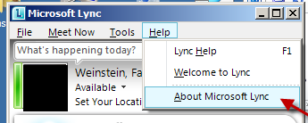
Client Software
To check for version of Lync:
Live Meeting will remain and will be required for joining older meetings created in OCS. If it gets uninstalled, it needs to be reinstalled.

Slide 7
Client Software
MAC has its own version of Lync software:
https://vaww.portal2.va.gov/sites/LYNC/MAC CLIENT FILES

Slide 8

Client has been migrated to Lync
Several ways to determine if user is now migrated Lync user
Lync Management Console
Active Director shows the server as:
ONLY Use AD to read!
Use Lync Management Console only for Lync Users and to migrate Legacy OCS users to Lync

Slide 9
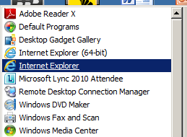
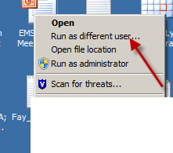
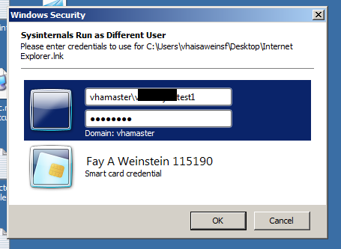
Lync Management Console
To access the console using etoken accout
1.Using IE 32 bit, right click on the icon
2. Select Run as different user…
3. Run using your admin account

Slide 10
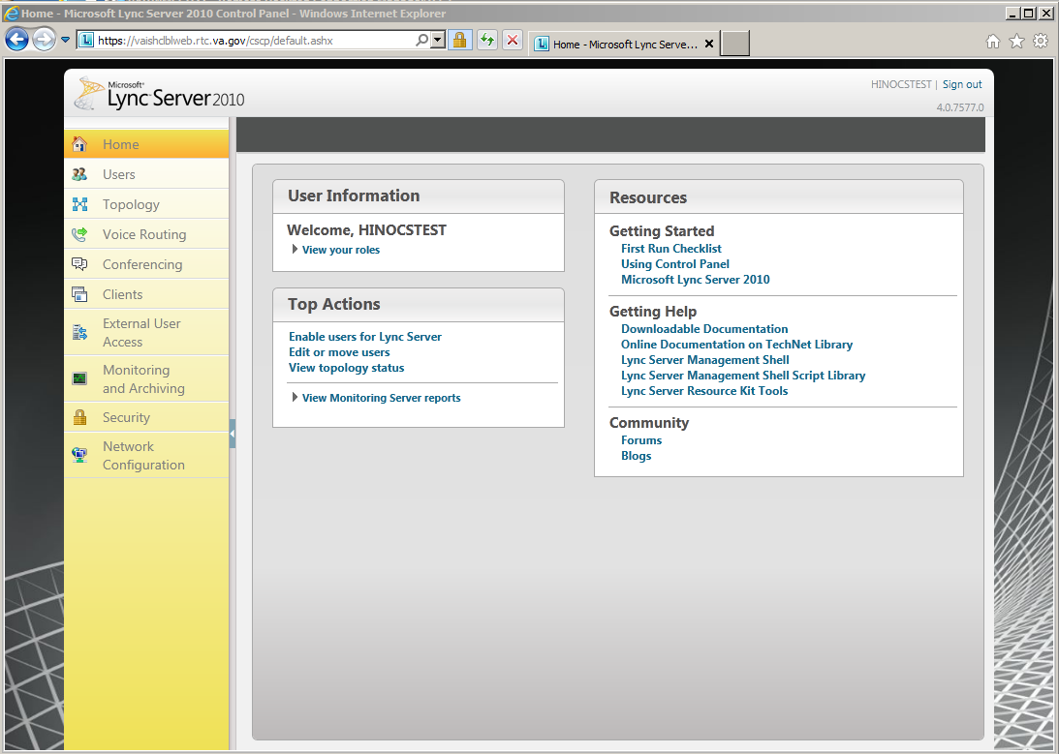
Lync Management Console
Go to: Https://Admin.rtc.va.gov
Please be patient it takes a good minute or so to connect.

Slide 11
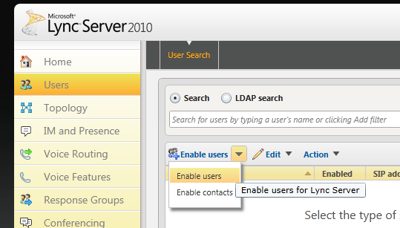
Lync Management Console
To Enable a new user and home them on a Lync Pool
1. Click on Users in the left pane
2. Click on Enable Users in the center pane

Slide 12
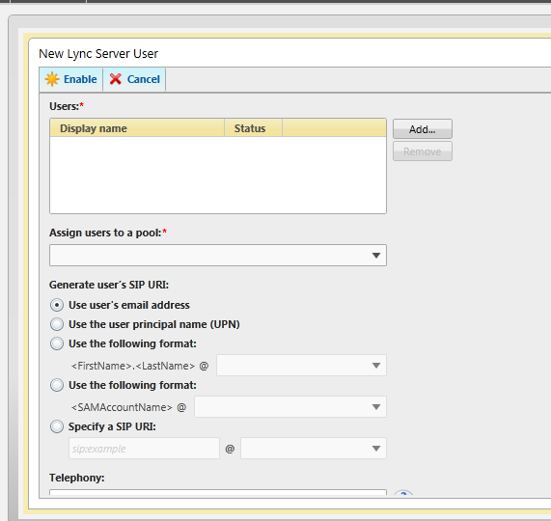
Lync Management Console
Click on Add

Slide 13
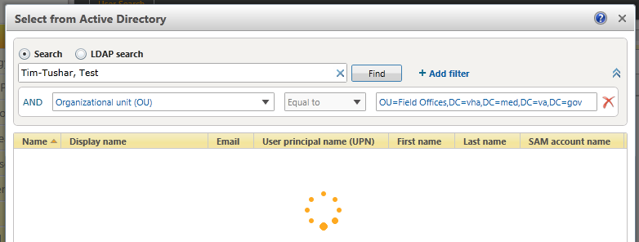
Lync Management Console
Add Filter “Organizational Unit (OU)
Alternate Filter:
Email equals ___
Without filter tool will only spin!

Slide 14
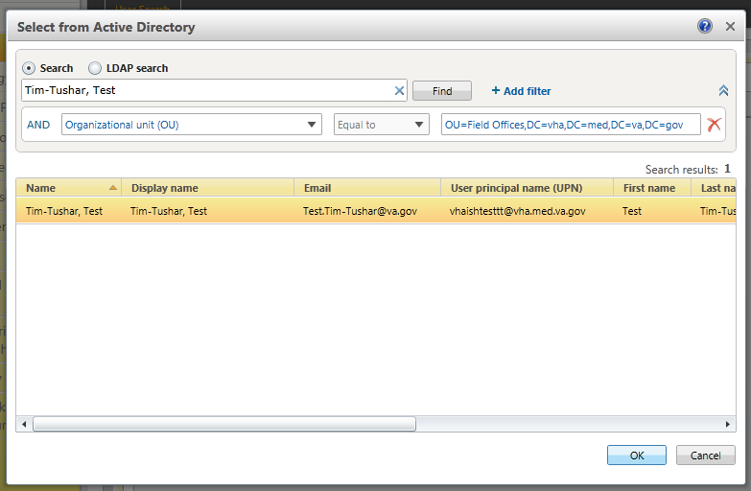
Lync Management Console
Click on user to highlight then click ok

Slide 15
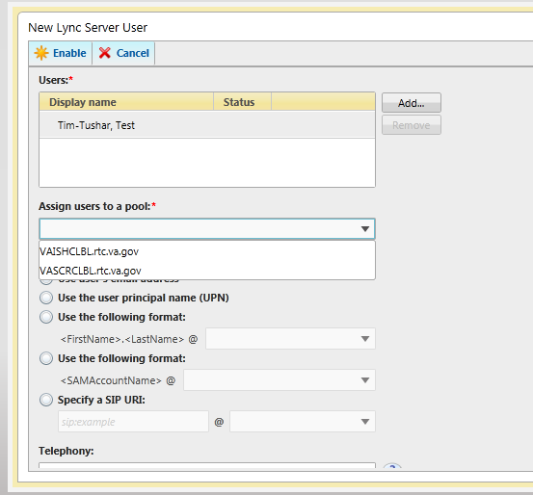
Lync Management Console
Click on down arrow “assign users to a pool”
R01 Select
VASCRCLBL.rtc.va.gov
R03 and AAC Select
VAAACCLBL.rtc.va.gov
R02, VBA, VHA, FPO, OIG Select
VAHINCLBL.rtc.va.gov
R04, VACO, and CEM Select
VAPHCCLBL.rtc.va.gov
DO NOT modify anything else

Slide 16
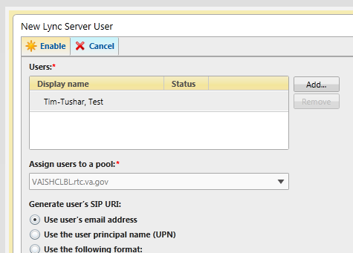
Lync Management Console
Click enable

Slide 17
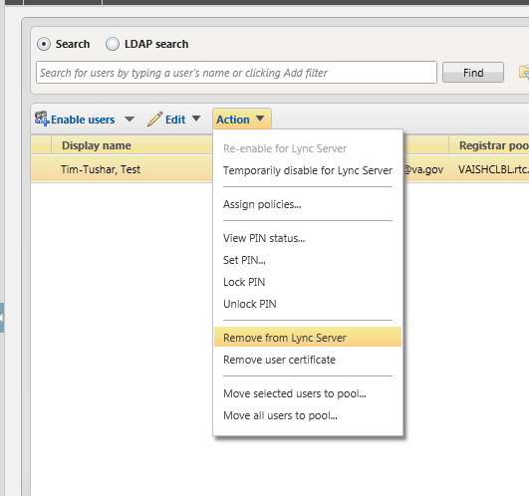
Lync Management Console
To remove user from Lync
Find user by typing Display name into search field, do not use a filter
Highlight user and click on action
Select “remove from Lync Server”
Note: 1st step when moving a user from one domain to another!

Slide 18
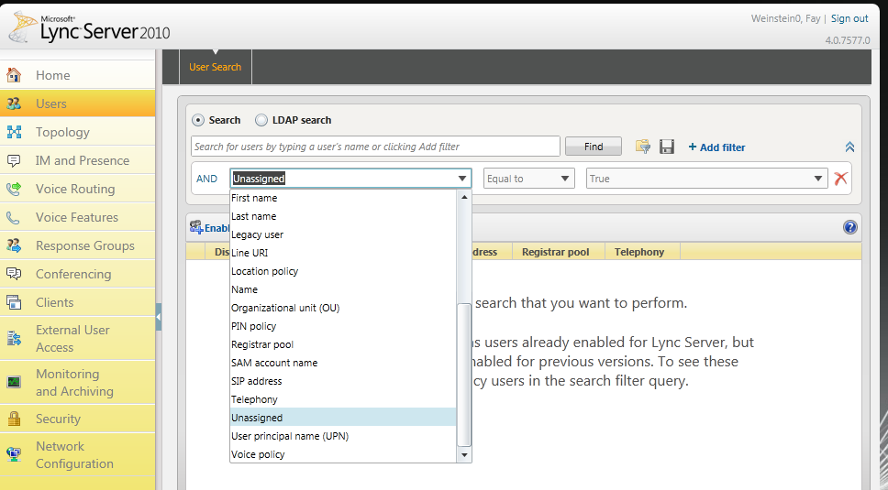
To find a user with a Sip Address but NOT homed on any pool
Change filter to “unassigned” equal to True

Slide 19
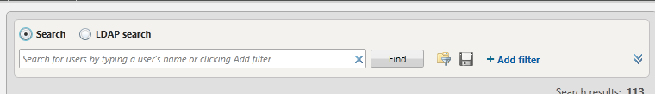
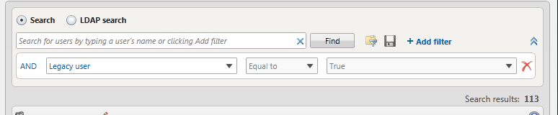
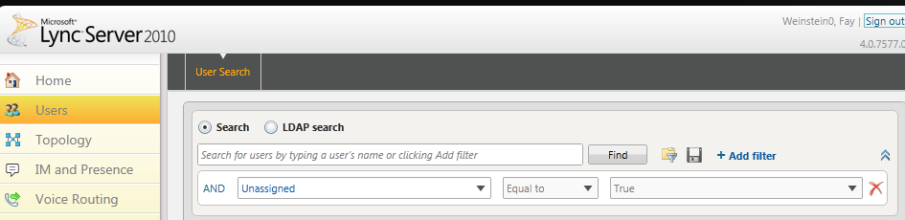
Filters
Filters
NO filter finds everyone in Lync
Searching for a user by OU Add organizal unit equal to : You have to find the Distinquished Name of the OU you want to use in AD and copy and paste it into the field to the far right.
User with Sip Address but not homed on any pool Add “unassigned” NOTE: It will take 24 hours before Line URI is applied to account

Slide 20
Address Book
Address book is now a web service – not downloaded to every workstation/computer
Errors:
Server is not available
Correction: log out and exit-relaunch
VPN users may have tried to launch Lync before completely connecting to Rescue
Alternate search – use full email address
Can remove GALContacts.db file on user’s workstation this file may no longer be up to date

Slide 21
BlackBerry
There is a client that can be pushed to the Blackberry which allows the user to log onto either OCS or Lync
Client can be attained by opening Remedy ticket with BES group
Same client for either OCS or Lync

Slide 22
FIPS compliant
OCS is FIPS 140-2 compliant
Lync 2010 is FIPS 140-2 Compliant
Field Security Services approves use of Lync to communicate PII and PHI
See bulletin: 95_MS Lync Communicator
Challenges: We do not archive messages or conferences
Must not save conversations to Outlook
Conversation once added to Outlook is unencrypted

Slide 23
Future Integrations
Enterprise Video Telecommunications Network (EVTN)
Currently testing with VACO test systems
IOS/Android
Telephony

Slide 24
R0XSipAdmin
Security Group which gives local admin rights to add/delete users
Rights will be removed during transition stage
Interim solution:
Open Remedy ticket with NSD and CIS Collaboration team

Slide 25
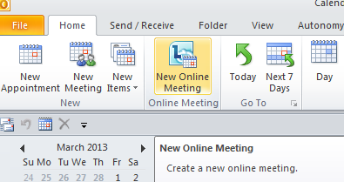
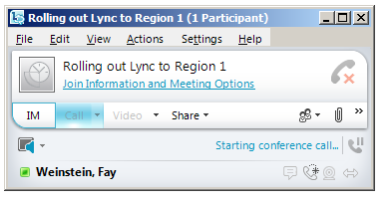
Highlights of Lync Meeting Changes
Create meetings with new button
Meeting looks like IM Window

Slide 26
Highlights of Lync Meeting Changes
Meeting options
When creating the invitation there is a meeting option button
In the meeting you can make changes by clicking on “Join Information and Meeting Options”
Upload Files - click on paperclip
Users can download
Sharing applications of desktops
Click on Share (if using multiple monitors always select main monitor or attendee cannot really see what you are showing)

Slide 27
Audio Conference Bridge
New number in Lync meetings
855-767-1051
If you need to use VANTS
You must now delete the conference number in the invitation and type in VANTS information
You can mute everyone, then each person that needs to be heard can unmute themselves

Slide 28
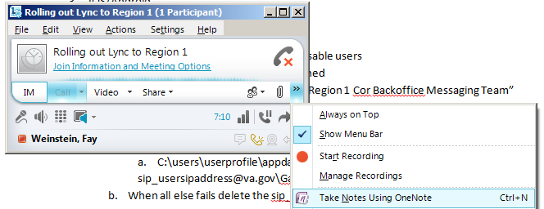
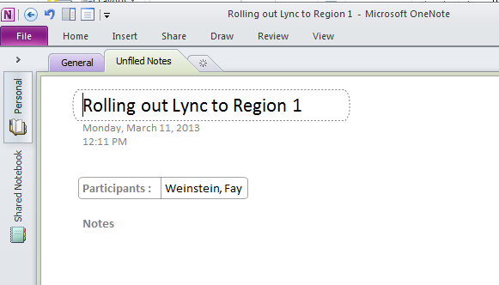
Attendence List
Click on double >> then select “take notes Using OneNote

Slide 29
Questions and Answers
Thank you for your attention. This document and others can be found on our Share Portal Site: https://vaww.portal2.va.gov/sites/LYNC/SitePages/Home.aspx

